Slide 1
Android Apps: Building Blocks
Module 6, Intro to I.T., Fall 2011
Sam Scott

Slide 2
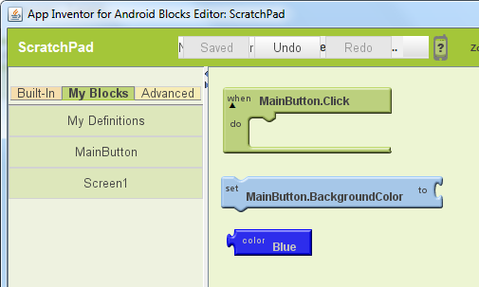
Basic Block Types
“When Do”
Actions to take when events happen
“Set To”
Set a property to a given value
Expression
Colors, numbers, text, etc.
The shape of each block shows its type.

Slide 3
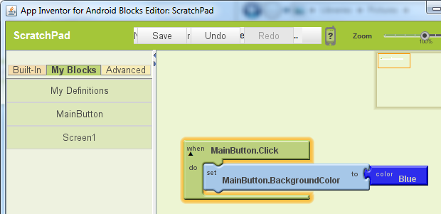
Blocks should snap together
When the main button is clicked
Set the main button background color to
Blue

Slide 4
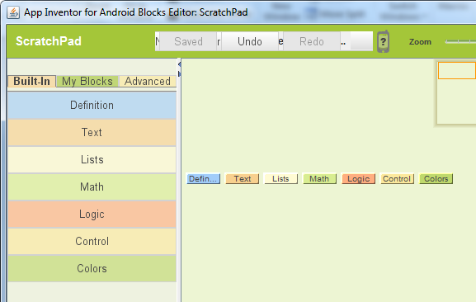
Math and Text
Click on “Built In”, or just click on the canvas to bring up the menu of Math, Text, and other expressions.

Slide 5
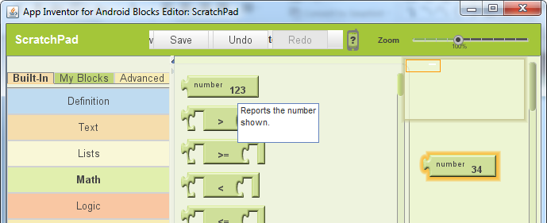
Math: Plain Numbers
Click “Math” and choose “123” to get a number block.
You can click on the number in the block to change it.
Then you can plug it into any “set to” block

Slide 6
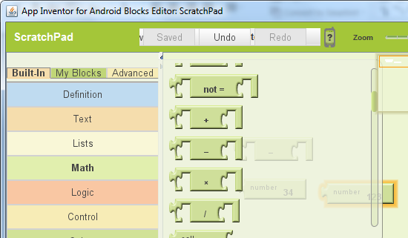
Math: Arithmetic
To do arithmetic, choose one of the four operations…

Slide 7
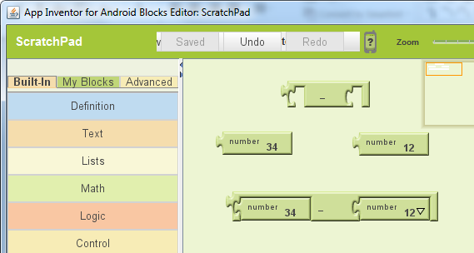
Math: Arithmetic
Then plug in some number blocks.
This is 34 - 12

Slide 8
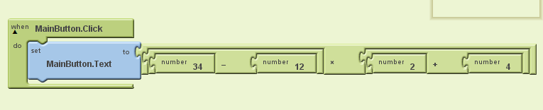
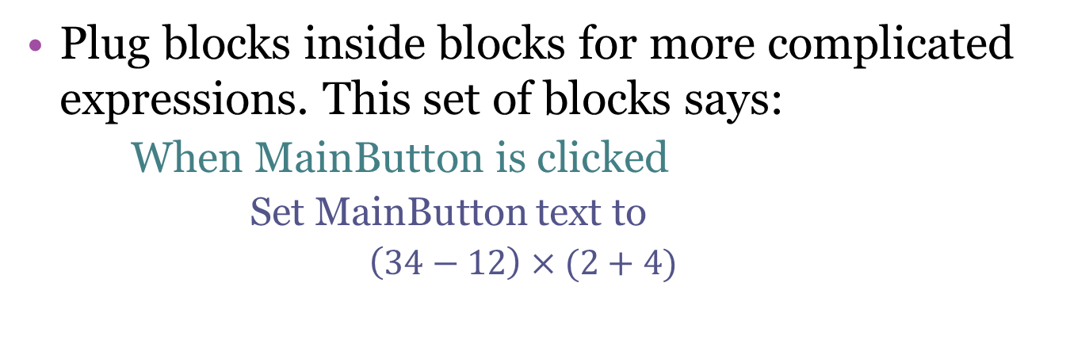
Math: Arithmetic
Plug blocks inside blocks for more complicated expressions. This set of blocks says:
When MainButton is clicked
Set MainButton text to
$\left(34−12\right)×(2+4)$

Slide 9
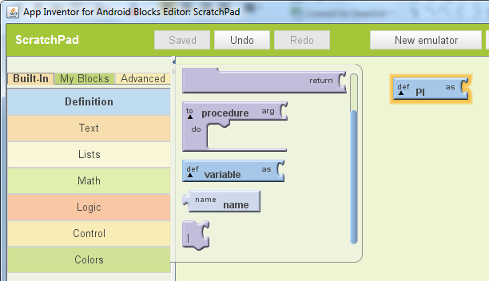
Defining Variables
A variable is a container that holds a value
Number, text, color, true/false, etc.
Variables are created from the “Definition” menu.

Slide 10
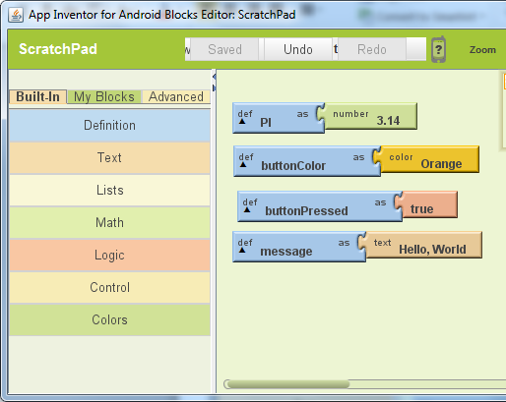
Giving Variables Values
You have to plug in a value or expression to tell the system what the variable stands for

Slide 11
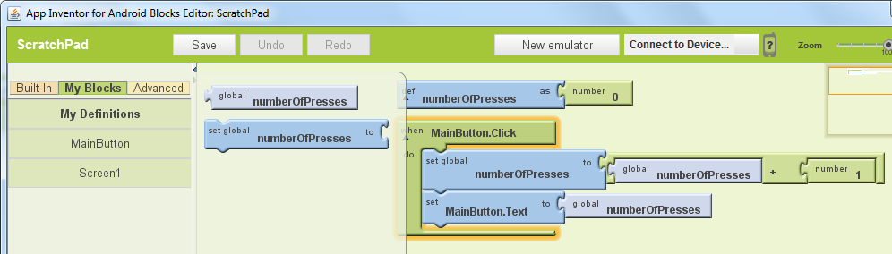
Working with Variables
Access variables from the My Definitions menu.
The above set of blocks will count the number of button presses by adding one to the global variable each time the button is clicked.

Slide 12
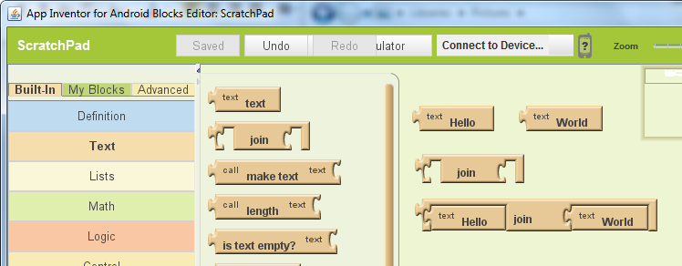
Working with Text
Text works a lot like numbers
“text” creates a text value like “Hello” or “World”
Join pieces two bits of text together
E.g. “Hello” join “World” = “HelloWorld”

Slide 13
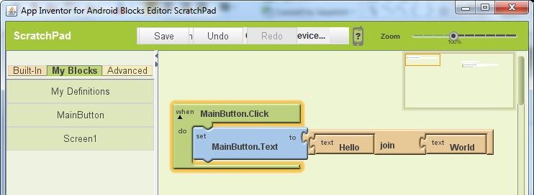
Working With Text
What does this program do?

Slide 14
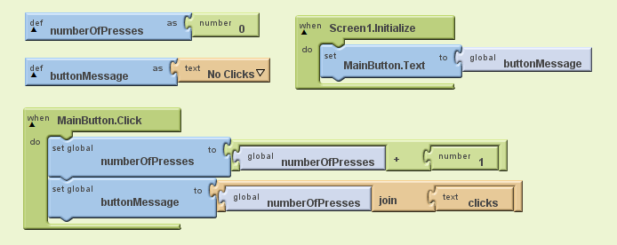
Working With Text and Numbers
What does this program do?
Hint: Screen1.initialize is an event that happens when you first start the App.

Slide 15
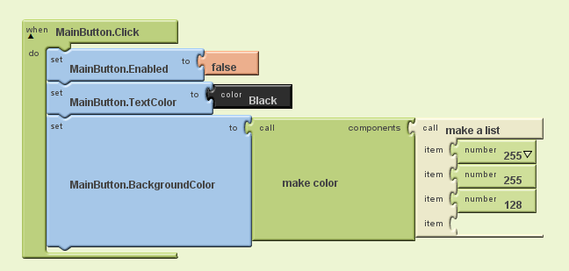
Boolean and Colour Values
A “Boolean” value can be true or false
You can use built in colors
Or you can create colors with the “Make Color” block
But you have to plug in “Make a List” with the red, green, and blue values (0 to 255)

Slide 16
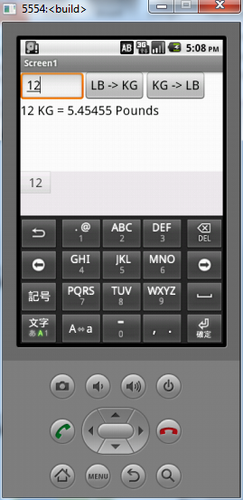
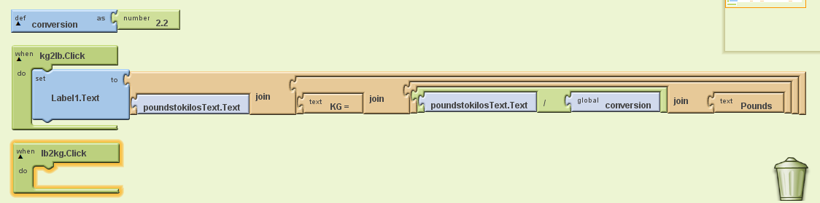
The Math Helper: Exercise 1
What you’re given
Uses a text box
Only KG->LB works
Exercise 1
Get the LB->KG button working

Slide 17
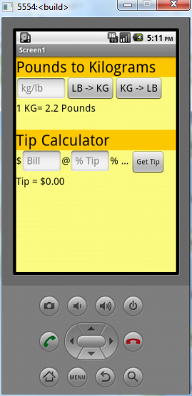
The Math Helper: Exercise 2
Add a Tip Calculator
E.g. I enter $100.00 and 15% and it says Tip=$15.00
Round to two decimal places
Hint: Find the “FormatAsDecimal” block under “Math”
Make it look nice
If you have time, play with the colors, fonts, etc. to make it look good.

Slide 18
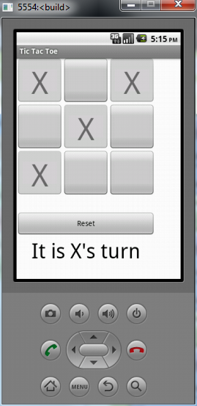
Tic Tac Toe Project
Main Buttons
Place an X
Disable the button
Make a sound
Reset Button
Enables all buttons
Clears all buttons
Makes a sound
Label
Just says it’s x’s turn
Make it look good
Nicer than the example
Extra Bonus
See if you can figure out how to make it places X then O then X etc.

